Slide 1

HDFS

Slide 2

Why Hadoop and Why not existing system (Limitation of existing system)
Problem of vertical scaling
User A 20G
Storage
Memory (HD)
Smart Phone
4 GB RAM
32GB Internal Storage
64 GB -can be extended
SD card (128 GB )
Vertical Scaling
Processing (CPU)
Alex can process 20 G of Data .What will be happen if Alex needs to process 25 G of Data (Add more Storage )
What about if data keep increasing.
You can increase the capacity but there is a limit for it (If I add a sd card of 128 GB to smart phone it can not support it) –Problem of vertical scaling

Slide 3
Big Data
Banks regulator
Trades with US
Banks do 100 M trades a day * 10 years .What are the challenges ?
Storing the data (text) each message around 2kb of data so it will be 50 -60 GB of data per day
In a month :1500 GB (~ 1.5 TB)
In a year (~ 18 TB)
In 10 years (~180 TB)
There are many data center can store 180 TB of data but what about fetching a data
Big Data is Any amount of data when your traditional system can not store and process the data.
i.e 10 GB for a table (select *from Table1) ? 40 second
Select few columns(5 columns) ? 5 minutes
Now put the condition (like where ) ? Around 45 minutes
Just think a bout 180 TB of data ? It takes Months .In another way its impossible

Slide 4

Database Server
Database (Storage )
.dbf
Database Server
RAM
Instance
BGP (back ground process )
What any DB server consist of ? (Physical machine) .

Slide 5
Database Server
Database Server
RAM
Instance
BGP (back ground process )
Client
(Summary of Employee Table)
Database
(Storage )
.dbf
Client establish a connection to an instance .Instance will contact to physical storage and it will search for data .That search cause issue
Data will be send to RAM
On top of that will process it

Slide 6
Limitation
Database Server
RAM
Instance
BGP (back ground process )
Client
(Summary of Employee Table)
Network
100 MB/Sec
1TB
Database
(Storage )
.dbf
My BW is 100 MB/Sec then how long does it takes to transfer 1 TB of Data from storage to your computation in instance?
1 TB =1024 GB =1024 *(1024MB) = 1048576 MB 1048576 MB /100 MB =10485 S = 174 Minutes =2.9 Hours
Processing has not started yet .It just takes 3 hours to transfer our data to processing grade.

Slide 7
What about 1 PB of Data
1PB =2.912711111 HOURS *1024 /24 = 124.27 Days
It takes 125 days to transfer to your instance even not starting the process

Slide 8
Limitation of existing system
Server limitation (Horizontal vs Vertical)
Transfer of data over the Network

Slide 9
Distributed Computing
Divide our data to smaller data and process separately then aggregate it
The time it takes for all the nodes to process = the time for one node
Limited hardware
Hadoop is a software (Framework) which applied in the cluster and take care of all things.
Notes:
Divide the task (Who will aggregate the data ? Monitor ? Edge nodes are the interface between the Hadoop cluster and the outside network. ) It coordinates the process

Slide 10
What is Hadoop ?
Apache Hadoop is an open-source software framework used for distributed storage and processing of dataset of big data using the MapReduce programming model. It consists of computer clusters built from commodity hardware.

Slide 11
Why Hadoop and Why not existing system (Limitation of existing system)
20 GB
20 GB
20 GB
20 GB
Horizontal Scaling
Hadoop says I am not going to fight it to increase the capacity .Hadoop will add one more machine to get every goal
Each machine support 20 GB .If you need 40 GB of storage you use two machine .
If you need 60 GB of storage it will add one more and so on.

Slide 12
Hadoop
Virtual System
HD = HD1+HD2+HD3+HD4
Ram = R1+R2+R3+R4
CPU =C1+C2+C3+C4
Hadoop Distributed File System (HDFS)
Machine Node
Machine Node
Machine Node
Machine Node
Horizontal Scaling
Hadoop Cluster 4 Node
Node : Individual Machine in your system
Cluster : Collection of Nodes

Slide 13
Hadoop Components
Filesystem
HDFS
Execution Engine
MapReduce
Ecosystem Tools (Peripheral components) or optional component )
Hive
PIG (Apache Pig is a high-level platform for creating programs )
Sqoop (transferring data between relational databases and Hadoop)
Oozie (Scheduling)
Zookeeper (distributed configuration service )
Notes:
Every data has two aspect .The core of Hadoop is taking care of two things :
1.Storage (HDFS)
2.Processing (MapReduce)
You can not use the core directly .To use the core you need to use tools like Hadoop ecosystem tools.You can install optional component in Hadoop cluster.
Hive (Data Warehousing tool-Structure and in some times semi structure)
PIG (ETL Tools -
Sqoop
Oozie
Zookeepere have many distribution : Mapper ,Amazon ,Hortonworks ,Cloudera. Depends on which distribution you are using those tools may vary
Different types of Data ? Structure ,semi structure ,un structure data
Structured data : any data which is human readable (salary table ,…) .It has a schema
Unstructured data : twitter ,Face book ,someone start his/her sentence with emoji ,someone starts with : ….. So there is no rules to follow. There is no pattern to follow .No schema
Semi structured data : It has a schema but it can not be always imposed every time . like xml file .it had DTD (defines the valid building blocks of an XML document.) dtd :A document type definition
One element in element may occur multiple time ,one element in xml may not occur at all.
One element in XML could be c data or character .One element could be p data or parse data (Any thing can be in parse data)

Slide 14
How Hadoop is trying to resolve these problems
Machine Node
Machine Node
Machine Node
Machine Node
Abc.txt
300MB
No Update possible in Hadoop
Add some file
Drop some file
WORM
Write once and Read /Process Multiple times

Slide 15
How Hadoop is trying to resolve these problems
128MB
B1
B1
B2
B3
Abc.txt
300MB
128MB
B2
44 MB
B3
No Update possible in Hadoop
Add some file
Drop some file
WORM
Write once and Read /Process Multiple times
Data Blocks
Block size :128
Each data is divided to 128 data blocks

Slide 16
How Hadoop is trying to resolve these problems
128MB
B1
B1
B2
B3
Abc.txt
300MB
L
L
L
128MB
B2
44 MB
B3
No Update possible in Hadoop
Add some file
Drop some file
WORM
Write once and Read /Process Multiple times
Data Blocks
Block size :128
Notes:
Why we are not using the third machine ? We might have thousands of machine .It could be any three machine
Imaging you wrote a query of 8000 lines , how much space does it require in your HD ? Around 2kb (Max 15 kb) (Logic )
Hadoop is saying that I am not going to transfer your data over the network which I am going to transfer the logic which its size will be very small to those physical machine which has available data lock

Slide 17
How Hadoop is trying to resolve these problems
Divide and rule Parallel Processing Distributed computation
128MB
B1
B1
B2
B3
Abc.txt
300MB
L
L
L
128MB
B2
44 MB
B3
No Update possible in Hadoop
Add some file
Drop some file
WORM
Write once and Read /Process Multiple times
Data Blocks
Block size :128
Notes:
Each machine use their local resources .(Local RAM ,CPU,…)
While we are processing B1 with the help of L
We are processing B2 with the help of L
We are processing B3 with the help of L

Slide 18
Hadoop
Hadoop S/W
FOC
Father of Hadoop (Doug Cutting )
Cloudera/Hortonworks
MapR
Hadoop is free even if you want to put it in production
These corporation will provide support on your Hadoop
What would be the first point they arise ? Costing ,Support
Are they HW coming free of cost ?

Slide 19
Hadoop
Hadoop S/W
FOC
Father of Hadoop (Doug Cutting )
Introduce Cloudera
Hortonworks
MapR
Those machine does not require very high level machine
--------------------------------
Cheaper
Or Commodity Hardware
--------------------------------
Data precious of cheap HD (Problem – What about if it fails )
Hadoop is free even if you want to put it in production
These corporation will provide support on your Hadoop
What would be the first point they arise ? Costing ,Support
Are they HW coming free of cost ?

Slide 20
Hadoop Solution
Cheaper
Commodity Hardware
Data precious
128MB
B1
B1
B1
B2
B1
Abc.txt
300MB
B2
B2
B3
B3
128MB
B2
B3
44 MB
B3
Data Replication
Replication Factor : 3
Data Blocks
Block size :128
Hadoop is going to create three copies of data and make it available in each machine
Advantage : ?

Slide 21
Advantage
Cheaper
Commodity Hardware
Data precious
128MB
B1
B1
B1
B2
B1
Abc.txt
300MB
B2
B2
B3
B3
128MB
B2
B3
44 MB
B3
Data Replication
Replication Factor : 3
Data Blocks
Block size :128
Hadoop is going to create three copies of data and make it available in each machine
Advantage : If we are losing Machine 2 we still have our data in Machine 1 ,3,and 4
High Data availability
Have you come to the situation that google come to you and say sorry I have lost your email (gmail)
Google is going to store in 6 machine (different geographical location)

Slide 22

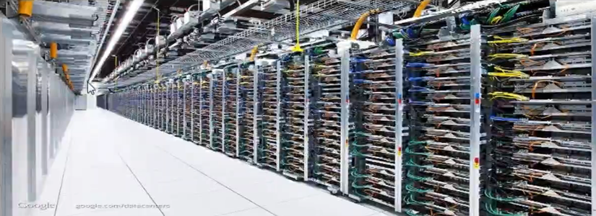
Data Center
Lets talk a bout one rack (14 machine)
Similar to the 2nd rack and so on.

Slide 23
Rack Awareness
R1N1
R2N5
B1
Abc.txt
300MB
B2
B3
Data Blocks
Block size :128
R3N12
3 Rack 12 Node cluster
Notes:
Rack Awareness in Hadoop is the concept that chooses closer Datanodes based on the rack information. By default, Hadoop installation assumes that all the nodes belong to the same rack. To improve network traffic while reading/writing HDFS files in large clusters of Hadoop

Slide 24
Rack Awareness
R1N1
R2N5
B1
B1
Abc.txt
300MB
B2
B1
B1
B3
Data Blocks
Block size :128
R3N12
3 Rack 12 Node cluster

Slide 25
Rack Awareness
R1N1
R2N5
B1
B1
Abc.txt
300MB
B2
B1
B1
B2
B2
B3
B2
Data Blocks
Block size :128
R3N12
3 Rack 12 Node cluster

Slide 26
Rack Awareness
R1N1
R2N5
B1
B1
Abc.txt
300MB
B2
B1
B1
B2
B3
B2
B3
B2
B3
Data Blocks
Block size :128
B3
R3N12
3 Rack 12 Node cluster

Slide 27
Rack Awareness
R1N1
R2N5
B1
B1
Abc.txt
300MB
B2
B1
B1
B2
B3
B2
B3
B2
B3
Data Blocks
Block size :128
B3
R3N12
If I lose one machine I still have our data available in other machine

Slide 28
Rack Awareness
R1N1
R2N5
B1
B1
Abc.txt
300MB
B2
B1
B1
B2
B3
B2
B3
B2
B3
Data Blocks
Block size :128
B3
R3N12
If I lose one rack I still have our data available in other machine or rack

Slide 29
Intra rack communication
R1N1
R2N5
B1
B1
B1
Abc.txt
300MB
B2
B2
B1
B2
B3
B2
B3
B3
B3
Data Blocks
Block size :128
R3N12
What about if I copy in one rack each Data block ? Do you think it make sense ? Yes but we are not using it.
Notes:
If R1N1wants to communicate with R2N5 it will be direct connection

Slide 30
INTER RACK Communication
Switch
Switch
Switch
R1N1
R2N5
B1
B1
B1
Abc.txt
300MB
B2
B2
B1
B2
B3
B2
B3
B3
B3
Data Blocks
Block size :128
R3N12
Notes:
R1N1 –R1N2 < R1N1 – R2N5 (More expensive) why we are copying two copy in the same rack .
It will be inter rack communication so we are coming to optimal solution
< From rack to rack they have to go through switch.(two switch)

Slide 31
Metadata
R1N1
R2N5
B1
B1
B1
Abc.txt
300MB
B2
B2
B1
B2
B3
B2
B3
B3
B3
This is not my data
Information about my data
B1 ,B2,B3
B1 :Machine 1,6,9
B2 : 2,6,10
B3 :3,6,11
Metadata
R3N12
Notes:
Whenever you want to read your data how you know where is those data? So you need to keep those information .Metadata
Bank account example

Slide 32
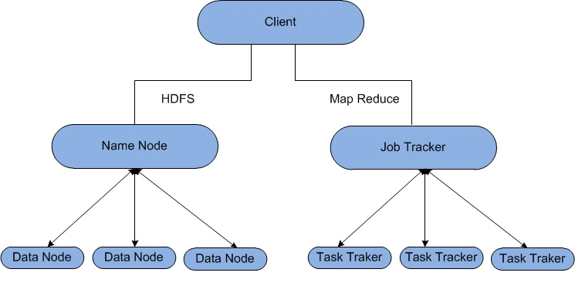
Hadoop Architecture v1.x

Slide 33
Master vs Slave
Master
NameNode
Slave
DataNode
Slave
DataNode
Slave
DataNode
Master Machine vs slave machine
Process (NameNode)
We do not save the Metadata in the commodity HW (Bank account info is lost but my money (data) is available)

Slide 34
Master
Master
High end Machine
All will be maintained by NameNode
RAM
Metadata
Why RAM is required ?there might be multiple users asking for it.
NameNode is the process for taking care of MetaData

Slide 35
Master vs Slave
Heartbeat 3 sec
After every 10 HB Block report
Master
NameNode
Heartbeat
Slave
DataNode
Slave
DataNode
Slave
DataNode
Heartbeat will be sent Every 3 second from slave to master to say I am alive and ready to take your order
Block report is the information for each block available in each machine.

Slide 36
Master
Master
High end Machine
NameNode
RAM
Metadata
Does Master Machine break down ? Yes
If we lose it we lose our metadata and we can not retrieve our data.
So we need back up.

Slide 37
Back up Machine
Master
NameNode
Back up Machine
RAM
Metadata
HDFS
ADD Some files
Delete some file
We can not make changes

Slide 38
Back up Machine
Master
NameNode
Back up Machine
RAM
Metadata
FS Image
FS Image
HDFS
ADD Some files
Delete some file
We can not make changes
8 AM
Whatever is in my RAM (Metadata ,I am going to take back up and it calls File system )
This FS file will be made available in back up

Slide 39
Back up Machine
Master
NameNode
Back up Machine
RAM
Metadata
FS Image
Edit Log
FS Image
HDFS
ADD Some files
Delete some file
We can not make changes
8:15 AM :1EL
From 8 am to 8:15 am we have add some files so it will add Edit log
Its incremental changes

Slide 40
Back up Machine
Master
NameNode
Back up Machine
RAM
Metadata
FS Image
Edit Log
FS Image
HDFS
ADD Some files
Delete some file
We can not make changes
Edit Log
8:30 AM :2EL
From 8:15 am to 8:30 am we have add some files so it will add another Edit log
Its incremental changes

Slide 41
Back up Machine
Master
NameNode
Back up Machine
RAM
Metadata
FS Image
Edit Log
FS Image
HDFS
ADD Some files
Delete some file
We can not make changes
Edit Log
Edit Log
8:45 AM :3EL
From 8:15 am to 8:30 am we have add some files so it will add another Edit log
Its incremental changes from 8:30 am to 8:45 am will be saved in another edit log

Slide 42
Back up Machine
Master
NameNode
Back up Machine
RAM
Metadata
FS Image
Edit Log
FS Image
HDFS
ADD Some files
Delete some file
We can not make changes
Edit Log
Edit Log
9:00 AM 4EL
Edit Log
At 9 am I am going to apply all the edit logs into the FS Image in back up machine
Result : whatever its available in RAM (Metadata ) is completely sync with back up machine

Slide 43
Secondary NameNode
Master
NameNode
Back up Machine
Secondary NameNode
RAM
Metadata
FS Image
Edit Log
FS Image
HDFS
ADD Some files
Delete some file
We can not make changes
Edit Log
Edit Log
9:00 AM 4EL
Edit Log

Slide 44
Secondary NameNode
Master
NameNode
Back up Machine
Secondary NameNode
Cold Back up (No Online)
Hadoop Gen 1
RAM
Metadata
8:00 AM : FSI
8:15 AM :1EL
8:30 AM :2EL
8:45 AM :3EL
9:00 :4 EL
FS Image
Edit Log
FS Image
HDFS
ADD Some files
Delete some file
We can not make changes
Edit Log
Edit Log
8:59 AM
Edit Log
At 8:59 am Machine will be failed.
What I have as Back up : FS Image which I had from 8 am. Whatever I had the changes from 8 am to 8:59 am will be lost. So I can use cold back up to retrieve the data
Hadoop Gen 1 has this issue

Slide 45
How to resolve it
Edit Log
Master
NameNode
Back up Machine
Standby NameNode
RAM
Metadata
Hot Back up
FS Image
FS Image
Problem was we had back up machine which had the back up. But we notice from previous slides we lost back up.so we need to send to the shared location.

Slide 46
Zookeeper
Zookeeper
Master
NameNode
Slave
DataNode
Slave
DataNode
Slave
DataNode
Zookeeper Ensue at any point of time all the slave machines are reporting to master machine.

Slide 47
High Availability
Edit Log
Master
NameNode
Back up Machine
Standby NameNode
Zookeeper
RAM
Metadata
Hot Back up
FS Image
FS Image
High Availability (HA)
:

Slide 48
Increase RAM of the Master Machine
Metadata
Machine Node
Machine Node
Machine Node
Machine Node
Are you able to procced if the master RAM is full so there will be no room for Metadata. You might be able to increase the ram to address it .Can we keep increasing it ? (vertical scaling issue)

Slide 49
Solution for this issue ?(Increase RAM of the Master Machine)
Virtual stock
Metadata
Metadata
Machine Node
Machine Node
Machine Node
Machine Node
Federation (Hadoop Gen 2)
Add another Master .These two machines are master.(apply the horizontal scaling ).These two machine is going to behave a single machine. They only maintain some Metadata

Slide 50
Hadoop Installation
1.Fully Distributed Mode
Whatever we covered so far
Replication:3
2.Psedo distributed Mode
One single machine (Master)
NameNode
Datanode
HDFS
Replication:1

Slide 51
Write Anatomy
Write Anatomy
Hdfs dfs –put Localfilesystempath HDFSpath
Machine
Node
Master
NameNode
Batch /abc.txt
B1,B2,B3
B1:3,2,6
B2:4,5,7
B3:11,21,9
ABC.txt
300 MB
B1
Base of rack awareness
Why is 3,2,6 ? Why is not 2,6,3 ?
B2
B3
Notes:
Write Anatomy means It is all about putting the data in to the HDFS.
Your first point of contact will be your master

Slide 52
Rack Awareness
R1N1
R2N5
B1
B1
Abc.txt
300MB
B2
B1
B1
B2
B3
B2
B3
Logged On
B3
B2
Data Blocks
Block size :128
B3
R3N12
3 Rack 12 Node cluster
We always select the machine which is closest to the machine which we logged on.(We logged on R2N6)

Slide 53
Sequence
R1N1
R2N5
B1
B1
Abc.txt
300MB
3
2
B2
B1
B1
B2
B3
B2
1
B3
Logged On
B3
B2
Data Blocks
Block size :128
B3
R3N12
Logged on R2N6
We always select the machine which is closest to the machine which we logged on.(We logged on R2N6)
On what base the selection of machine is done ? based on space availability and Rack awareness .
Sequence is decided based on proximity with respect to the machine you logged on .

Slide 54
Write Anatomy
Three process are running on the machine which you logged on
Data Queue
Data Streamer
Acknowledgement queue
We are only talking about B1
Write Anatomy
Hdfs dfs –put Localfilesystempath HDFSpath
Machine
Node
MASTER
NameNode
Batch /abc.txt
B1,B2,B3
B1:3,2,6
B2:4,5,7
B3:11,21,9
B1
ABC.txt
300 MB
B1
DQ
M3
M2
M6
B2
DS
B3
AQ

Slide 55
Write Anatomy
B1 IS 128 MB and its divided to 16 MB so 8 section.those packet (P1,P2,P3,P4,P5,P6,P7,P8) ARE part of DQ
Write Anatomy
Hdfs dfs –put Localfilesystempath HDFSpath
Machine
Node
MASTER
NameNode
Batch /abc.txt
B1,B2,B3
B1:3,2,6
B2:4,5,7
B3:11,21,9
B1
ABC.txt
300 MB
B1
DQ
M3
M2
M6
B2
DS
B3
AQ
Notes:
Data Queue
Data Streamer
Acknowledgement queue

Slide 56
Write Anatomy
Data Streamer will get meta data from B1 and write it to Machine 3
DS will take P1 and put it in AQ
DS will keep in touch with M3 and create a file there (in the Local file system ) and name it as B1then it writes this packet P1 on this
Write Anatomy
Hdfs dfs –put Localfilesystempath HDFSpath
Machine
Node
MASTER
NameNode
Batch /abc.txt
B1,B2,B3
B1:3,2,6
B2:4,5,7
B3:11,21,9
B1
P1
p6
ABC.txt
300 MB
B1
DQ
M3
M2
M6
B1
B2
DS
B3
(AQ)P1
Notes:
Data Queue
Data Streamer
Acknowledgement queue

Slide 57
After the packet is written the Machine number 3 will keep in touch with Machine number 2
And it will do the same thing and put packet P1 there
Now M2 will contact M6 and create a file there and put P1 there.
Write Anatomy
Hdfs dfs –put Localfilesystempath HDFSpath
Machine
Node
MASTER
NameNode
Batch /abc.txt
B1,B2,B3
B1:3,2,6
B2:4,5,7
B3:11,21,9
B1
P1
p6
ABC.txt
300 MB
B1
DQ
M3
M2
M6
B1
B1
B1
B2
DS
B3
(AQ)P1

Slide 58

After this is done .M6 will response back to M2 and says I am done with it
M2 will reply back to M3
Then M3 will response to DS and confirm P1 has successfully written in all machines
Write Anatomy
Hdfs dfs –put Localfilesystempath HDFSpath
Machine
Node
MASTER
NameNode
Batch /abc.txt
B1,B2,B3
B1:3,2,6
B2:4,5,7
B3:11,21,9
B1
P1
p6
ABC.txt
300 MB
B1
DQ
M3
M2
M6
B1
B1
B1
B2
DS
B3
(AQ)P1

Slide 59
After DS receive acknowledgement it will delete p1 from AQ and put p2 and do the same procedure
Write Anatomy
Hdfs dfs –put Localfilesystempath HDFSpath
Machine
Node
MASTER
NameNode
Batch /abc.txt
B1,B2,B3
B1:3,2,6
B2:4,5,7
B3:11,21,9
B1
P1
p6
ABC.txt
300 MB
B1
DQ
M3
M2
M6
B1(p2)
B1
B1
B2
DS
B3
(AQ)P2

Slide 60
After DS receive acknowledgement it will delete p2 from AQ and put p3 and do the same procedure
Write Anatomy
Hdfs dfs –put Localfilesystempath HDFSpath
Machine
Node
MASTER
NameNode
Batch /abc.txt
B1,B2,B3
B1:3,2,6
B2:4,5,7
B3:11,21,9
B1
P1
p6
ABC.txt
300 MB
B1
DQ
M3
M2
M6
B1(p3)
B1
B1
B2
DS
B3
(AQ)P3

Slide 61
After DS receive acknowledgement it will delete p7 from AQ and put p8 and do the same procedure
DS will receive ack For P8 so DS will contact NameNode and confirimB1 has been written successfully .I have written the data based on this Meta DATA
Write Anatomy
Hdfs dfs –put Localfilesystempath HDFSpath
Machine
Node
MASTER
NameNode
Batch /abc.txt
B1,B2,B3
B1:3,2,6
B2:4,5,7
B3:11,21,9
B1
P1
p6
ABC.txt
300 MB
B1
DQ
M3
M2
M6
B1(p8)
B1
B1
B2
DS
B3
(AQ)P8

Slide 62
Same Operation for B2
Write Anatomy
Hdfs dfs –put Localfilesystempath HDFSpath
Machine
Node
MASTER
NameNode
Batch /abc.txt
B1,B2,B3
B1:3,2,6
B2:4,5,7
B3:11,21,9
B2
P1
p6
ABC.txt
300 MB
B1
DQ
M4
M5
M7
B 2
B2
B2
B2
DS
B3
(AQ)P(1-8)

Slide 63
Same Operation for B3
Remember all operation happens simultaneously
B1,B2,B3 : are written in parallel
B1,B2,B3 :Parallel
B1:p1,P2,…P8 :Sequence
Write Anatomy
Hdfs dfs –put Localfilesystempath HDFSpath
Batch /abc.txt
B1,B2,B3
B1:3,2,6
B2:4,5,7
B3:11,21,9
Machine
Node
MASTER
NameNode
B3
P1
p6
ABC.txt
300 MB
B1
DQ
M11
M21
M9
B 3
B3
B3
B2
DS
B3
(AQ)P(1-8)

Slide 64
Failure
The procedure was successful so far but we do have the commodity HW so any time the failure may happen so we need to talk about this scenario .Assume P1 P2 is done and we are working on P3.So M2 will fail so AKW 8 will not received
So M3 will come to know that packet write operation to M2 failed .Same communication will be sent to DS.
Write Anatomy
Hdfs dfs –put Localfilesystempath HDFSpath
Machine
Node
MASTER
NameNode
Batch /abc.txt
B1,B2,B3
B1:3,2,6
B2:4,5,7
B3:11,21,9
B1
P1
p6
ABC.txt
300 MB
B1
DQ
M3
M2
M6
B1(p3)
B1
B1
B2
DS
B3
(AQ)P3
Notes:
https://www.youtube.com/watch?v=7sxqHgBdxB8

Slide 65
DS will take P3 and put it back in DQ and it will contact Master NameNode and Tell NameNode that B1 has been failed in M2 .NameNode will change the name of the block (B11) and please continue to write to other machine 3 and 6.This information will be sent to DS
Does NameNode has any information about packet ?No ,It has information about BLOCKS
DS will take P3 and Put it back in the AQ and it will communicate with M3
Write Anatomy
Hdfs dfs –put Localfilesystempath HDFSpath
Machine
Node
MASTER
NameNode
Batch /abc.txt
B1,B2,B3
B11:3,6
B2:4,5,7
B3:11,21,9
B1
P1
p6
ABC.txt
300 MB
B1
DQ (P3)
M3
M2
M6
B1
B1
B1
B2
DS
B3
(AQ)P3

Slide 66
DS will take P3 and Put it back in the AQ and it will communicate with M3 and it will change the name of the file to B11 then m3 will communicate to M6 directly and change the file to B11 and write the packet P3 there then M6 will confirm it directly to M3
M3 will contact DS and DS will delete P3 and Put P4 and do the same procedure
Write Anatomy
Hdfs dfs –put Localfilesystempath HDFSpath
Machine
Node
MASTER
NameNode
Batch /abc.txt
B1,B2,B3
B11:3,6
B2:4,5,7
B3:11,21,9
B1
P1
p6
ABC.txt
300 MB
B1
DQ (P3)
M3
M2
M6
B11
B1
B11
B2
DS
B3
(AQ)P3
Notes:
Data Queue
Data Streamer
Acknowledgement queue

Slide 67
DS will delete P3 and Put P4 and do the same procedure
Write Anatomy
Hdfs dfs –put Localfilesystempath HDFSpath
Machine
Node
MASTER
NameNode
Batch /abc.txt
B1,B2,B3
B11:3,6
B2:4,5,7
B3:11,21,9
B1
P1
p6
ABC.txt
300 MB
B1
DQ (P4)
M3
M2
M6
B11
B1
B11
B2
DS
B3
(AQ)P4

Slide 68
After DS will get confirmation for P8 it will contact Master NameNode and says that the data is written successfully on M3 ,6 based on Meta data
Write Anatomy
Hdfs dfs –put Localfilesystempath HDFSpath
Machine
Node
MASTER
NameNode
Batch /abc.txt
B1,B2,B3
B11:3,,6
B2:4,5,7
B3:11,21,9
B1
P1
p6
ABC.txt
300 MB
B1
DQ (P4)
M3
M2
M6
B11
B1
B11
B2
DS
B3
(AQ)P8

Slide 69
If M6 also fails (While you are writing P7) it will be the same scenario .NamaeNode will change the B11 to B12 and says DS to only write on M3.
Any of the write operation of any block can be successful if it is written successfully even in to one machine.
If all the three machines fails then the error will be displayed
Write Anatomy
Hdfs dfs –put Localfilesystempath HDFSpath
Machine
Node
MASTER
NameNode
Batch /abc.txt
B1,B2,B3
B12:3
B2:4,5,7
B3:11,21,9
B1
P1
p6
ABC.txt
300 MB
B1
DQ (P4)
M3
M2
M6
B12
B1
B11
B2
DS
B3
(AQ)P7

Slide 70
Questions
Under replication
Further machine fails
Why B1-B11
Corrupted block B1

Slide 71
Under replication Issue
There is HDFS balance in Master which come to know about B11 or M2,6 so it will contact to NameNode and ask for the third machine to make sure the replication factor remains to 3 so Name Node will says to load balance to save it to M78
Write Anatomy
Hdfs dfs –put Localfilesystempath HDFSpath
HDFS Balancer
Machine
Node
MASTER
NameNode
Batch /abc.txt
B11,B2,B3
B11:3,6 ,78
B2:4,5,7
B3:11,21,9
B1
P1
p6
ABC.txt
300 MB
B1
DQ (P4)
M3
M2
M6
B11
B1
B11
B2
DS
B3
(AQ)P7

Slide 72
M2 Back to production
When M2 is sending a heartbeat is fine however after 10 HB is sending the block report .This block report says that I have one block called B1 .HDFS Balance check with Meta Data and notice there is no information in MetaData regarding B1 so it seems either B1 is corrupted or half written block
HDFS Balance will go to M2 and Delete B1
Write Anatomy
Hdfs dfs –put Localfilesystempath HDFSpath
HDFS Balancer
Machine
Node
MASTER
NameNode
Batch /abc.txt
B11,B2,B3
B11:2,6 ,78
B2:4,5,7
B3:11,21,9
P1
p6
ABC.txt
300 MB
B1
DQ (P4)
M3
M2
M6
B11
B1
B11
B2
DS
B3
(AQ)P7

Slide 73
Why B1 –B11
Supposed you keep it B1.After M2 come back and sends information to DS then ds sends to Master .Then how HDFS Load Balance will know Bi is corrupted or not ?
It will know only when you change it to B11 otherwise it can not recognize it.
Write Anatomy
Hdfs dfs –put Localfilesystempath HDFSpath
HDFS Balancer
Machine
Node
MASTER
NameNode
Batch /abc.txt
B11,B2,B3
B1:3,6 ,78
B2:4,5,7
B3:11,21,9
B1
P1
p6
ABC.txt
300 MB
B1
DQ (P4)
M3
M2
M6
B1
B1
B1
B2
DS
B3
(AQ)P7
Notes:
Data Queue
Data Streamer
Acknowledgement queue

Slide 74
Read Anatomy
Write Anatomy
Hdfs dfs –cat HDFS FilePath
Machine
Node
Client
NameNode
Batch /abc.txt
B1,B2,B3
B1:,6 ,3 ,78
B2:7,5,4
B3:11,21,9
We want to read abc.txt which is divided to B1,B2,B3.Do I need to read B1 from all the three machine or one is enough ? One machine
Why Name Node is sending complete information for Metadata to client if one Machine will be read ? For example if you are reading B1 on M6 then what will happen if M6 fails because NameNode already gave you the information about the other two you will not come back to NameNode and ask for 3 and 78.
What is the logic behind this sequence ? 6 ,3 ,78 .

Slide 75
What is the logic behind this sequence ? 6 ,2 ,1 .
R1N1
R2N5
B1
B1
Abc.txt
300MB
3
2
B2
B1
B1
B2
B3
B2
1
B3
Logged On
B3
B2
Data Blocks
Block size :128
B3
R3N12
I logged on to R2N7 NameNode is going to calculate the distance with respect to the machine which you logged in and the machine which the data is available So reading the data from same rack is easier to read it from different rack.
We read from nearest node to avoid inter communication
Notes:
https://www.youtube.com/watch?v=7sxqHgBdxB8

Slide 76
Write Anatomy
Hdfs dfs –cat HDFS FilePath
Machine
Node
Client
NameNode
Batch /abc.txt
B1,B2,B3
B1:,6 ,3 ,78
B2:7,5,4
B3:11,21,9
B1 :How are you
B2: I am fine
Read (B1,B2,B3) :Sequence
Processing :Parallel

Slide 77
Configuration
Configuration
Core-Site.xml
Hadoop-evn.sh
Hdfs-site.xml
Yarn-site.xml
Mapred-site.xml
XML
<Property >
<Name></Name>
<Value></Value>
</Property >
All configuration are available in XML Format.
There are 5 XML files are available
Its in /etc/hadoop

Slide 78
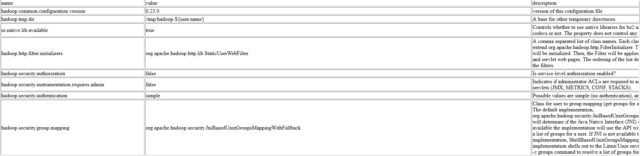
https://hadoop.apache.org/docs/r2.7.2/hadoop-project-dist/hadoop-common/core-default.xml

Slide 79
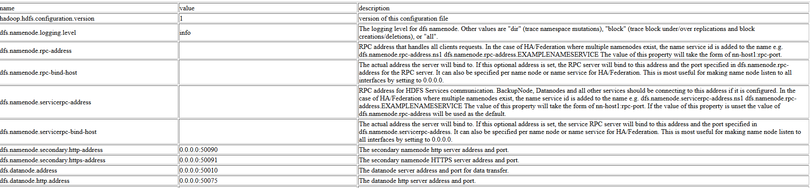
Hdfs-site.xml
https://hadoop.apache.org/docs/r2.4.1/hadoop-project-dist/hadoop-hdfs/hdfs-default.xml
Its impossible to talk about all properties. We are going to talk about few of them which are important

Slide 80
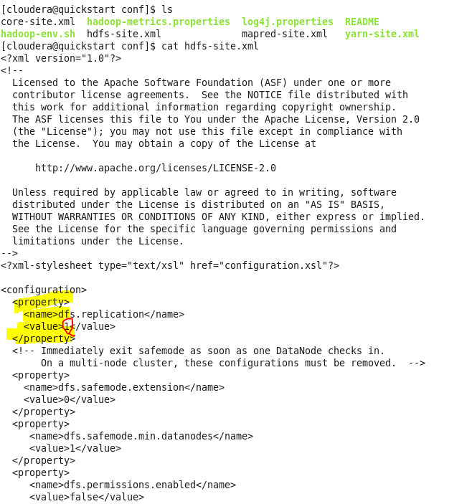
You see that as we are using one machine we see value for replication property is set to 1

Slide 81
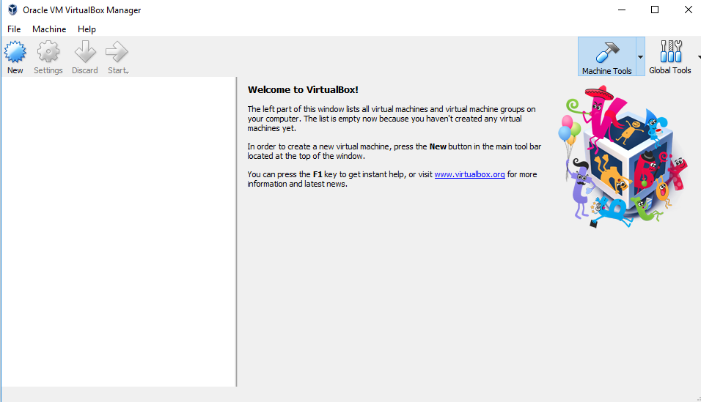
https://www.virtualbox.org/wiki/Downloads

Slide 82
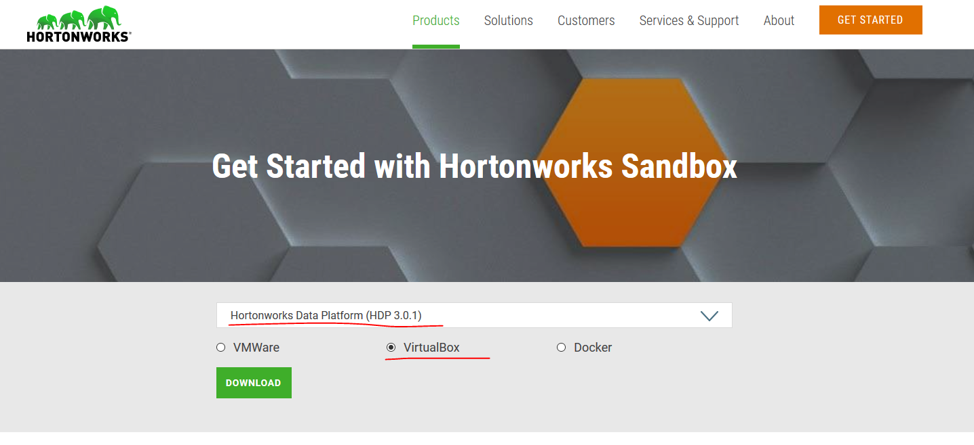

Slide 83
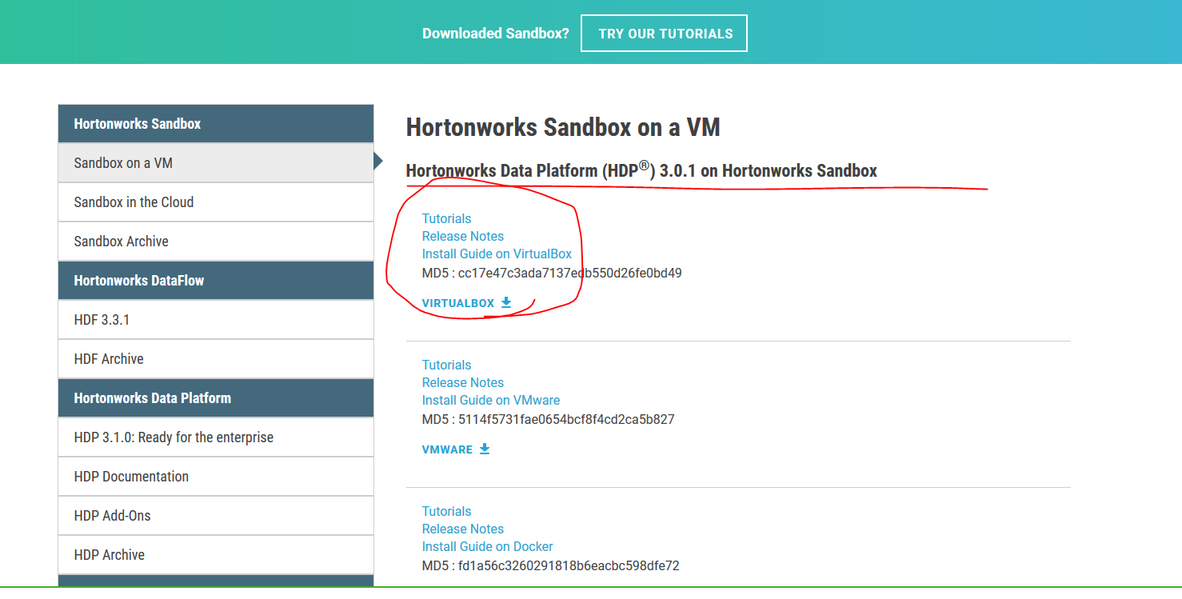
Notes:
https://hortonworks.com/products/sandbox/?utm_source=google&utm_medium=cpc&utm_campaign=hw_sandbox&utm_content=rlsa&gclid=EAIaIQobChMIyYjX64L63wIVpB-tBh0HGQKREAAYASAAEgIzFfD_BwE

Slide 84
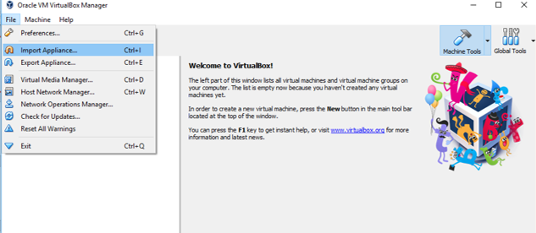
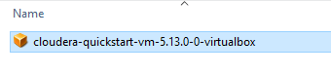
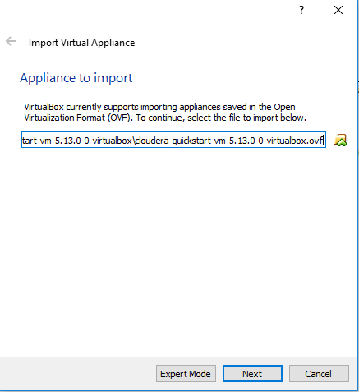

Slide 85
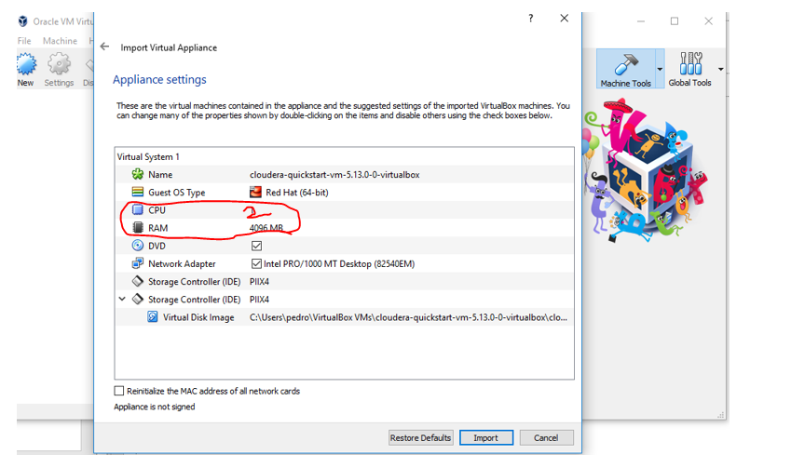
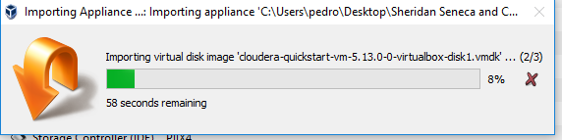

Slide 86
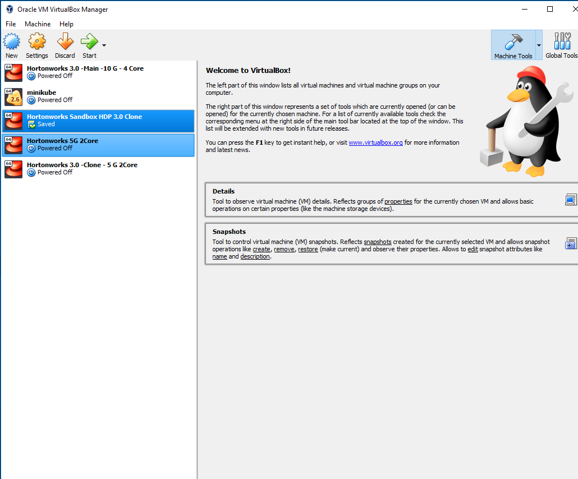

Slide 87
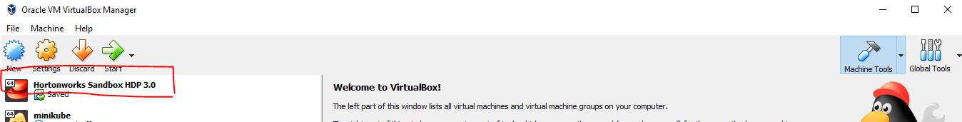

Slide 88
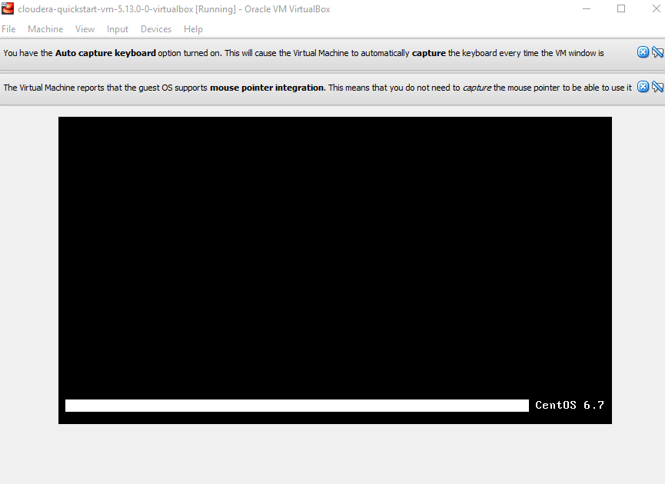

Slide 89
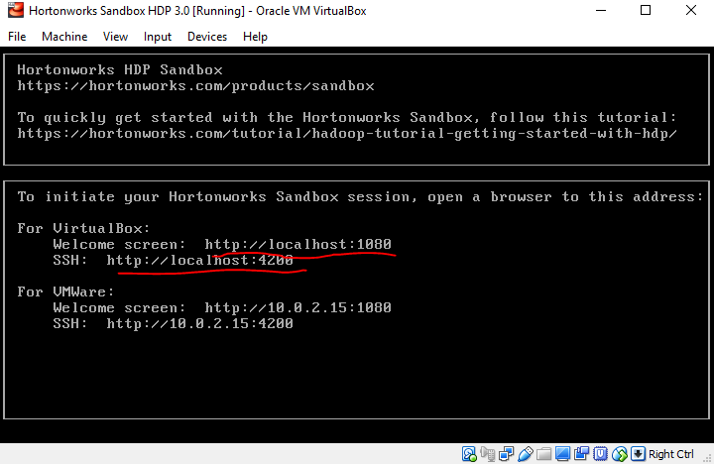

Slide 90
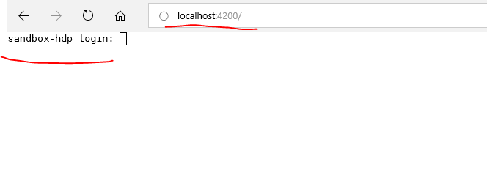
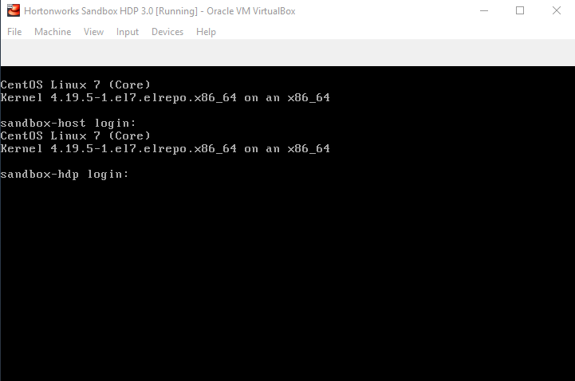
ALT+F5

Slide 91
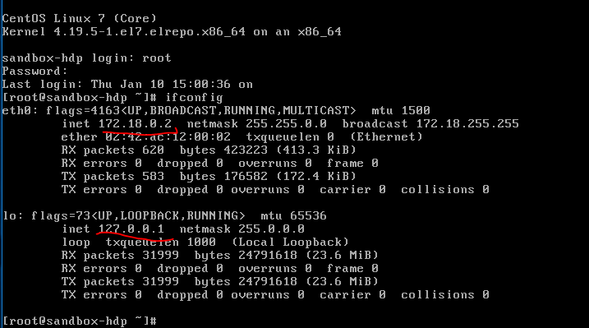
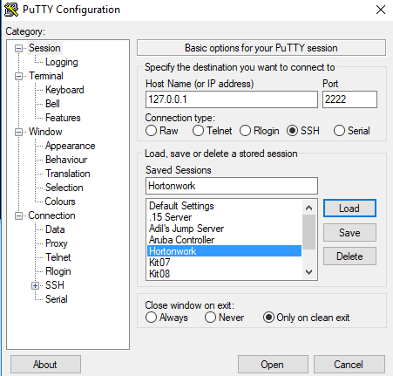

Slide 92
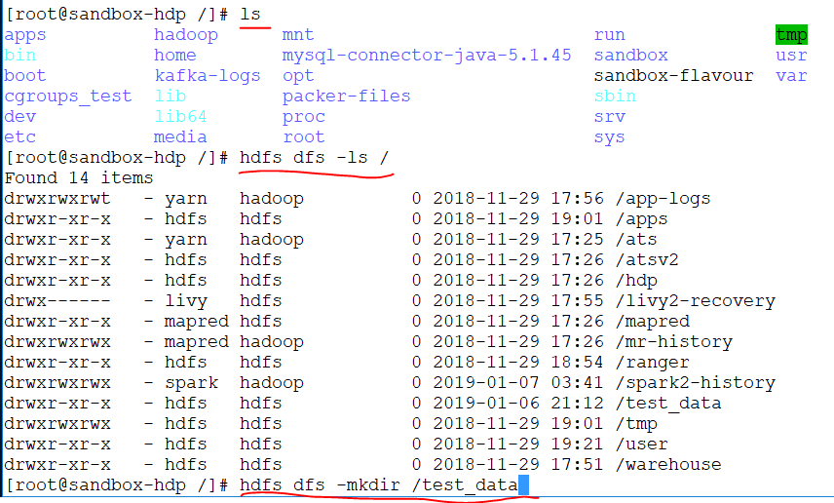

Slide 93
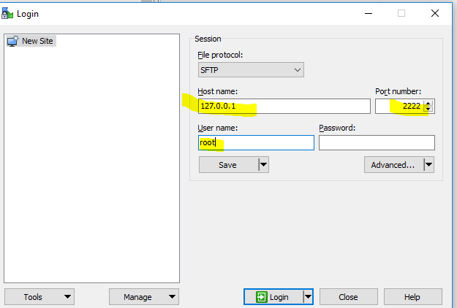
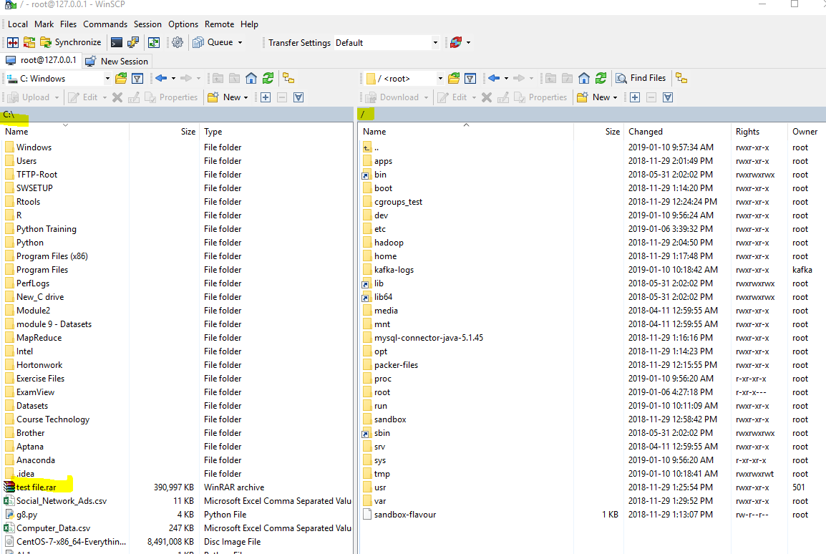

Slide 94
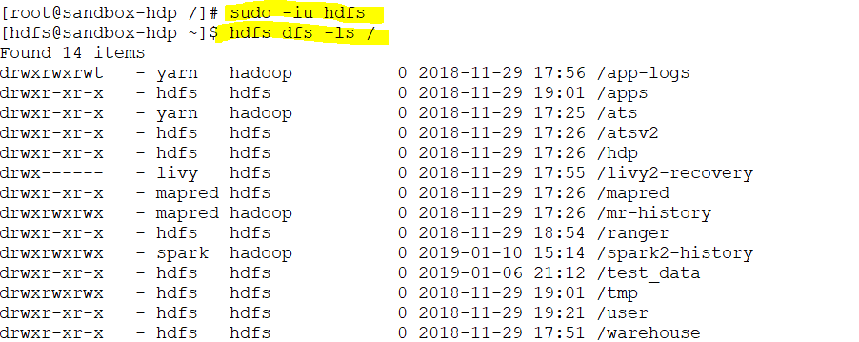
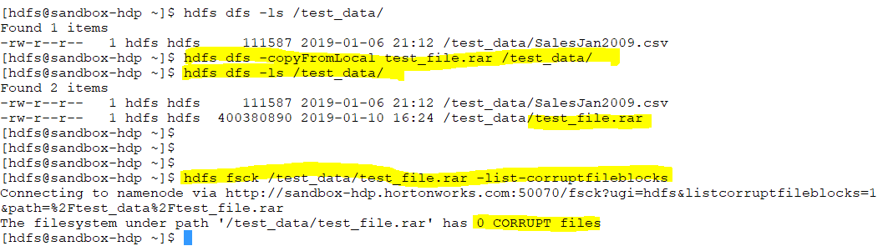
Notes:
https://hadoop.apache.org/docs/r2.4.1/hadoop-project-dist/hadoop-common/FileSystemShell.html
https://hadoop.apache.org/docs/r2.4.1/hadoop-project-dist/hadoop-common/FileSystemShell.html

Slide 95
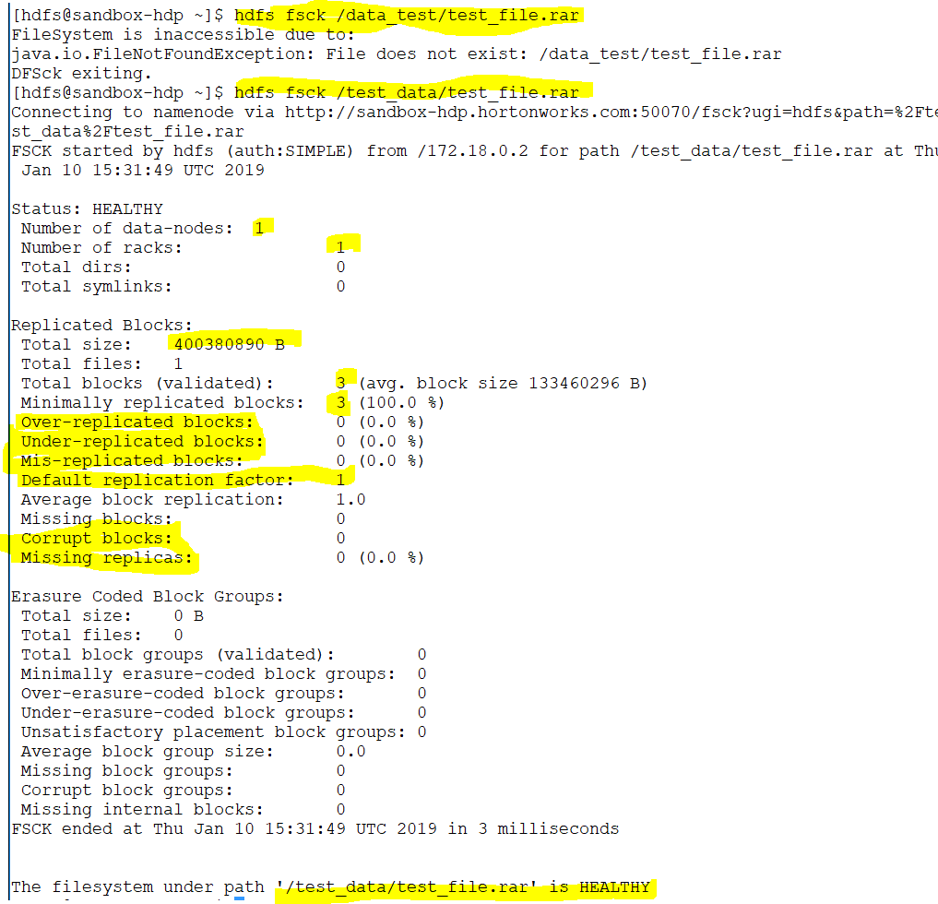
Notes:
All the information in the file in file system
In HDFS only the name node knows that there is a file and these are the block s of the files.no one else knows these blocks are pointing to a file.
The file size is 390 but in the command line shows 400 MB .It shows more

Slide 96
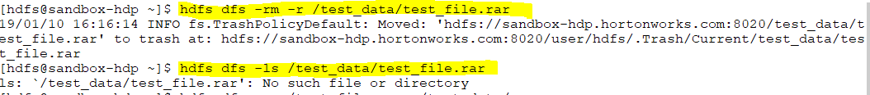
Notes:
Practice https://hadoop.apache.org/docs/r2.7.1/hadoop-project-dist/hadoop-common/FileSystemShell.html#appendToFile

Slide 97
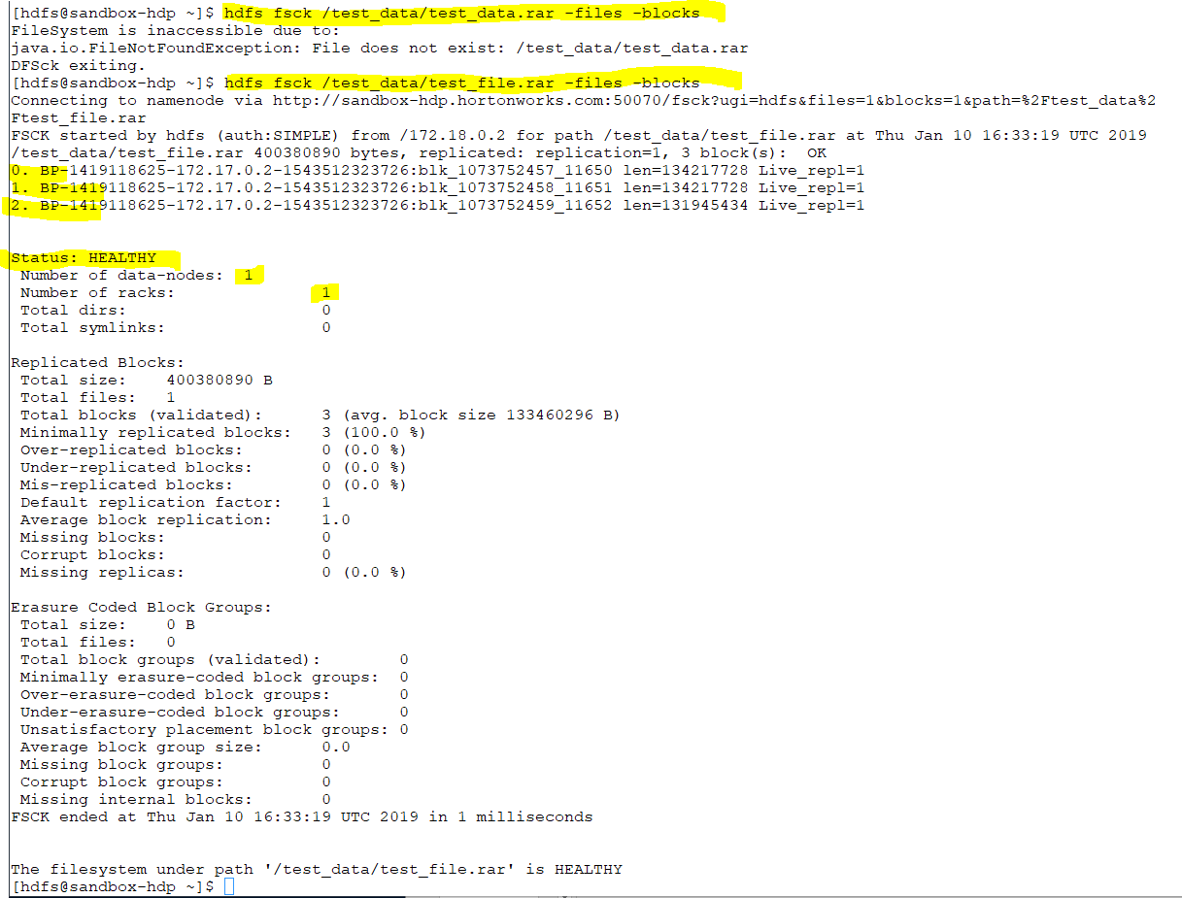
Notes:
Print out the block report
Its kind of summary
Fsck for developer
Dhfs for administrator

Slide 98
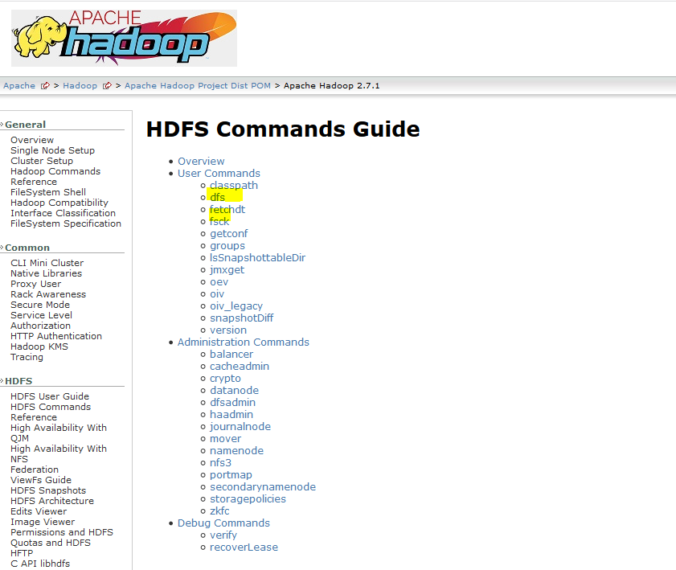
Notes:
HDFS command give us an ability to walk through the file
Fsck give us an ability to look into the actual file system .If we want to go to the actual block we use fsck

Slide 99
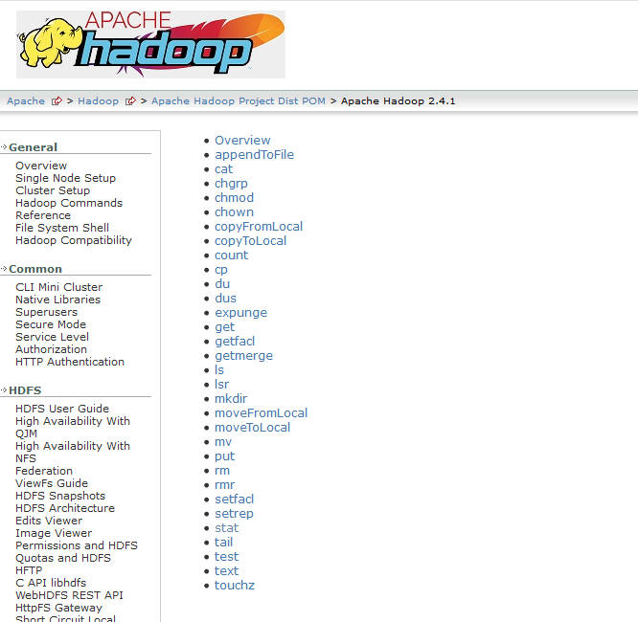
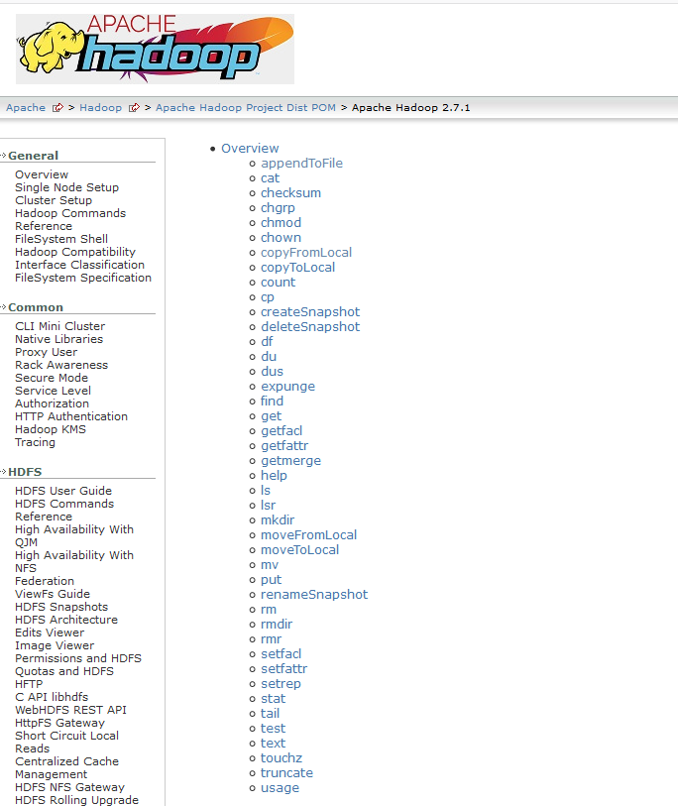
Notes:
https://hadoop.apache.org/docs/r2.4.1/hadoop-project-dist/hadoop-common/FileSystemShell.html
https://hadoop.apache.org/docs/r2.7.1/hadoop-project-dist/hadoop-common/FileSystemShell.html#appendToFile

